Slide 1
Legal Aid Chicago Menu Redesign
Presentation #5
Andrew Metzger, Alex Barbatsis, Daniel Gold, and Fai Poungpeth

Slide 2




EXECUTIVE SUMMARY
Potential Caller Capability Improvement
The current phone system has inefficiencies, which creates an opportunity to redesign the menu in order for LegalAid to be able to answer more callers
We propose a new menu design, which will help LegalAid reach more clients, as follows:
A
525 Hours Saved (i.e. 28.6 seconds saved per caller affected) [UPDATE BASED ON OTHERS’ WORK]
B
66,169 Number of Callers Impacted [UPDATE BASED ON OTHERS’ WORK]
C
48 Nodes and 57 Branches Reduced [UPDATE BASED ON OTHERS’ WORK]
D
?? More Calls Legal Aid Can Service [UPDATE BASED ON CYNTHIA’S RESPONSE]
Sources: CAR Data

Slide 3
LEGAL MENU REDESIGN
Reducing the # of options callers listen to, we can avoid confusion and save callers time from needing the many options repeated
Old Flow
New Flow
No/Invalid Input (x2)
No/Invalid Input (x2)
3rd Invalid Input
LegalMenu2
LegalMenu2
3rd Invalid Input
HIV
1
Main
Menu
3rd Invalid Input
2
10
1
2
3
4
5
6
Family
Other
Menu
Family
Housing
Benefits
Employ-
ment
Immi-
gration
Other
Legal1
Main
Menu
3
9
Housing
8
ADAPT
No/Invalid Input (x2)
4
1
4
5
2
3
Benefits
5
7
Immi-
gration
Criminal
Records
HIV
Consumer
Queue
ADAPT
Other
Legal2
6
Consumer
Queue
Criminal
Records
Employ-
ment
Qualified Benefit
36.6% of callers reach LegalMenu2, meaning simplifying this menu will have an impact on 57,538 callers
13.9% of those who go to the LegalMenu2 listen more than 1 time > fewer options will reduce this (less confusion)
Of those in LegalMenu2, the average number of times a person listens to the menu is 1.2 times > this will be reduced
The average amount of time it takes people to make a selection on this menu is 1 minute and 22 seconds > rearranging in this order will save callers 26 seconds (see next slide)
Although this increases the # of nodes by 1, it should reduce confusion and reduce the average amount of time a caller takes to reach their destination
Sources: CAR Data

Slide 4
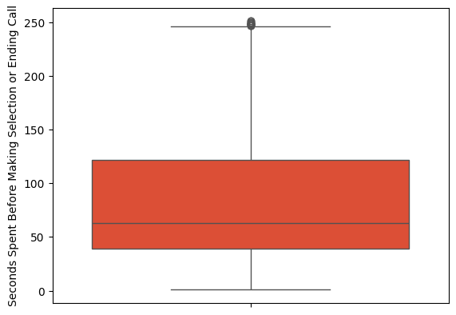
LEGAL MENU REDESIGN
A substantial number of callers take over 2 minutes before making a selection, which can be reduced significantly via the proposed change
Seconds Taken Old Flow
Estimated Seconds Taken New Flow
Will Decrease
The average amount of time spent before selecting a final option will drop to 56 seconds, representing a 26-second or 32% improvement per caller!
Will Stay Roughly The Same
Will Decrease
Will Decrease
Key Assumptions For Estimated Seconds Taken
The new proposed menu is 53 seconds shorter. So, instead of 13.9% of callers listening to the menu >1 times, this will be reduced to 5% given menu simplicity (assuming this is constant across issue type, this will save an average of 13.6 seconds)
Since the most frequently selected categories are asked first, 95%*65%=61.8% of callers who fall into the main 5 categories & don’t listen to the menu >once will reach their selections an average of 20 seconds quicker (Saving an avg of 12.4s)
The remaining 95%*35%=33.3% of callers who will go to OtherLegal1 without option repetition will save 0s (as the extra time spent selecting an extra node will balance out the saved time from the menu prioritizing highly-selected options)
So, the overall average saved time across all callers will be 13.6 seconds + 12.4 seconds = 26 seconds
Sources: CAR Data

Slide 5
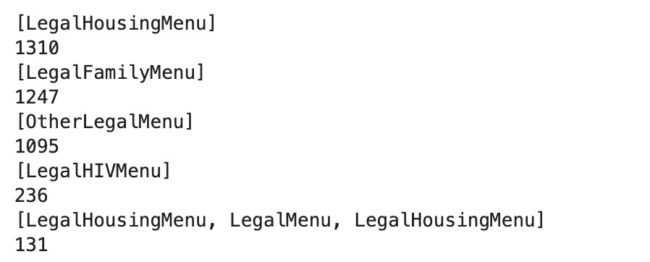
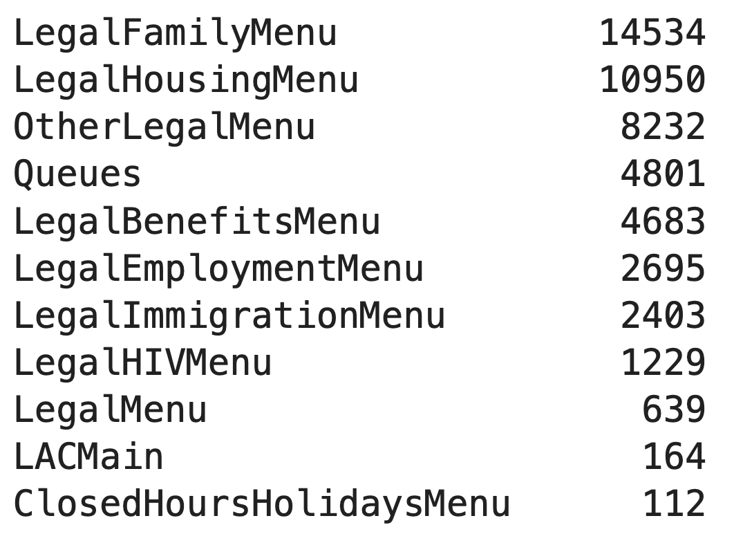
LEGAL MENU REDESIGN
We should refine/enhance the verbiage of the LegalHIV Menu Option, as people going to this menu are recycling back at the highest rate
#
Most Common Paths Between Repeated LegalMenu
%
1310
LegalMenu
LegalHousing Menu
LegalMenu
12.0%
1247
LegalFamily Menu
8.6%
1095
OtherLegal Menu
13.3%
236
LegalHIV Menu
19.2%
131
LegalHousing Menu
LegalMenu
LegalHousing Menu
1.2%
Key Commentary
A whopping 19.2% of callers who choose to go to the HIV Menu are immediately returned back to the LegalMenu
The current verbiage just asks if the caller or a family member is affected by HIV > Change to “If you are calling about…”
We may also refine the verbiage of the LegalHousing Menu as a sizeable chunk ~12% of callers go back to LegalMenu
Sources: CAR Data

Slide 6
MAIN MENU REDESIGN
Reducing the # of options callers listen to, we can avoid confusion and save callers time from needing the many options repeated
Old Flow
New Flow
No/Invalid Input (x2)
No/Invalid Input (x2)
MainMenu
MainMenu
3rd Invalid Input
Appoin-
tment
1
Front Desk
Transfer
3rd Invalid Input
1
3
2
4
5
7
2,6
Legal
Menu
Staff
Directory
Clinic
Voicemail
Appoint-
Ment
Other
Front Desk
Transfer
Address
Fax Hours
Staff Directory
5
4
No/Invalid Input (x2)
1
Compliment
Complaint
Clinic
Voicemail
2
3 / 3rd Invalid Input
3
8
Address
Fax Hours
Compliment
Complaint
Other (Front
Desk)
Pre-Legal
Help With
LegalOrOther
Key Recommendations
Since a lot of callers go to the MainMenu, this will affect 104,664 who spend an average time of 30.6s to make a choice
The menu is redesigned to ask the most selected options first
The verbiage for the 2 options that go to staff directory will be combined: For the staff directory or if you are trying to reach the attorney or paralegal you are already working with,, please press 2 (allows people to reach directory quicker)
Because of redundancy, the second other will take you directly to the front desk instead of asking if a legal issue (as they were already asked if they had a legal issue)
If selecting a legal issue, instead of going to pre-legal menu you can go directly to legal menu (and ask if senior later)

Slide 7
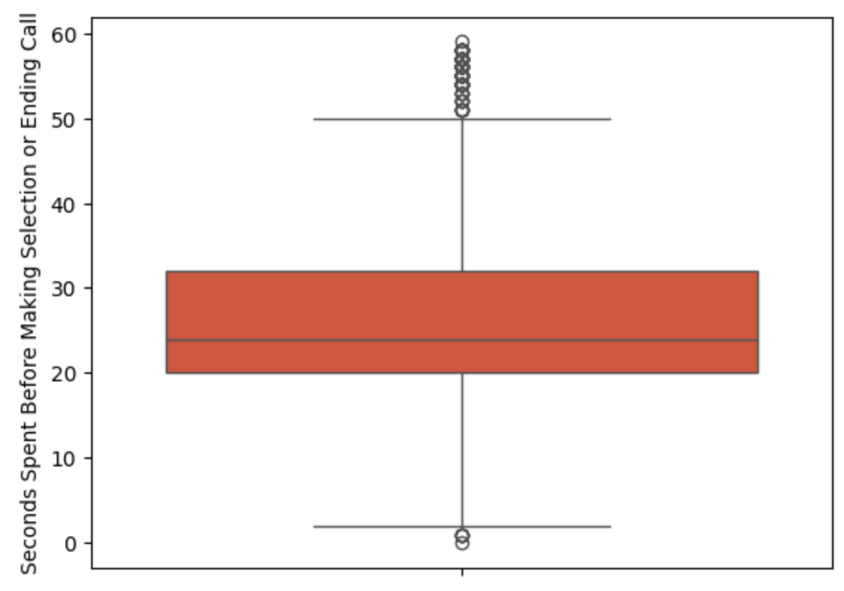
MAIN MENU REDESIGN
A substantial number of callers take over 30 seconds before making a selection, which can be reduced significantly via the proposed change
Seconds Taken Old Flow
Estimated Seconds Taken New Flow
Will Decrease
The average amount of time spent before selecting a final option will drop to 13.9 seconds, representing a 16.7-second or 45% improvement per caller!
Will Stay Roughly The Same
Will Decrease
Will Decrease
Key Assumptions For Estimated Seconds Taken
The new proposed menu is 20 seconds shorter. So, instead of 11.3% of callers listening to the menu >1 times, this will be reduced to 5% given menu simplicity (assuming this is constant across issue type, this will save an average of 4.8 seconds)
The most frequently selected categories are asked first, so 95%*83.5%=79.3% of callers who fall into the main 4 categories & don’t listen to the menu >once will reach their selections an average of 15 seconds quicker (Saving an avg of 11.9s)
The remaining 95%*16.5%=15.7% of callers who will go to Other without option repetition will save 0s (as the extra time spent selecting an extra node will balance out the saved time from the menu prioritizing highly-selected options)
So, the overall average saved time across all callers will be 4.8 seconds + 11.9 seconds = 16.7 seconds per caller, or 16.7*104,664 = 485.5 hours saved in total
Sources: CAR Data

Slide 8
SUMMARY
By incorporating these changes, LAC will improve the experience of [UDPATE], saving an average of[UPDATE] seconds per caller affected
Suggested Changes
1
Change 1: Reduce the number of options in the LegalMenu2 verbiage of the Legal Menu Call Flow
2
Change 2: Enhance the verbiage of the LegalHIV Menu Option
3
Change 3: Reduce the number of options in the MainMenu verbiage, combine the 2 options to get to Staff Directory into one statement
4
Change 4: Asking age and residence questions before queuing, and removing the Pre-Legal Seniors and Seniors Confirmation Menus [UPDATE]
5
Change 5: Moving up the Holiday and Open Hours check in LAC Main, and removing redundant checks in subsequent menus [UPDATE]

Slide 9
Questions?

Slide 10
Appendix

Slide 11
LEGAL MENU
Legal Menu Number Calculations
36.6% of callers reach LegalMenu2
13.9% of those who go to the LegalMenu2 listen more than 1 time
Formula: # of Callers that reach LegalMenu2 / Total # of Callers
= 57,538 / 157,360
Formula: # of callers listening > 1 time / Total legalMenu2 Callers
= 8,008 / 57,538
The average # of times a person listens to LegalMenu2 is 1.2 times
Avg time to make selection on LegalMenu2 is 1 min 22 seconds
Formula: # of times listened to / Total # of legalMenu2 goers
= 68,975 / 57,538
Formula: total seconds taken / number of legalmenu2 goers
= 4,238,580s / 51,955 non-null listeners = 82s
The new proposed menu is 53 seconds shorter
# of callers listening > 1 will reduce to 5%
This was found by timing the menu options via a test call
Assumption
An average of 13.6 seconds will be saved via 5% listening > 1 time
Most frequent category callers will save an avg of 20 seconds per call
Formula: 13.9% (perc who listen to legalMenu2 more than 1 time)*123s (old menu length) - 5% * 70s (new menu length)
Assumption based on the verbiage saved via rearrangement
An average of 12.4s will be saved for the most frequent category callers
overall average saved time across all callers will be 26 seconds
Formula: 95% (people not listening >1 time)*65% (% of callers in main categories)*20 seconds
13.6s saved via repeating options less on a smaller menu + 12.4s saved via rearrangement

Slide 12
LEGAL MENU
Legal Menu Number Calculations (Cont.)
19.2% of HIVMenu Goers go right back to LegalMenu2
LegalHousing Menu has ~12% of callers going back to LegalMenu
Formula: # of callers going back to LegalMenu2 / Total HIV Callers
= 236 / 1,229
Formula: # callers repeating LegalMenu2 / Total LegalHousing Callers
= 1,310 / 10,950

Slide 13
MAIN MENU
Main Menu Number Calculations
66.5% of callers reach MainMenu
11.3% of those who go to the MainMenu listen more than 1 time
Formula: # of Callers that reach MainMenu / Total # of Callers
= 104,664 / 157,360
Formula: # of callers listening > 1 time / Total MainMenu Callers
= 11,780 / 104,664
The average # of times a person listens to MainMenu is 1.1 times
Avg time to make selection on MainMenu is 30.6 seconds
Formula: # of times listened to / Total # of MainMenu goers
= 118,612 / 104,664
Formula: total seconds taken / number in MainMenu sample
= 29,706s / 971 non-null listeners = 30.6s
The new proposed menu is 20 seconds shorter
# of callers listening > 1 will reduce to 5%
This was found by timing the menu options via a test call
Assumption
An average of 4.8 seconds will be saved via 5% listening > 1 time
Most frequent category callers will save an avg of 15 seconds per call
Formula: 11.3% (perc who listen to MainMenu more than 1 time)*60s (old menu length) - 5% * 40s (new menu length)
Assumption based on the verbiage saved via rearrangement
An average of 11.9s will be saved for the most frequent category callers
overall average saved time across all callers will be 16.7 seconds
Formula: 95% (people not listening >1 time)*83.5% (% of callers in main categories)*15 seconds
4.8s saved via repeating options less on a smaller menu + 11.9s saved via rearrangement

